Slide 1
Project Overview (Progress Report) Cody Costa David loi mike tran
Goal: Implement autonomous drone navigation in AirSim using LiDAR and path planning.
Key Features:
- LiDAR-based 2D occupancy grid
- A* path planning
- PID altitude hold
- Obstacle avoidance (Local AI)
- Forward velocity control
- Real-time plotting and visualization

Slide 2
Initial Implementation
Language: Python
Libraries: airsim, numpy, scipy, matplotlib, torch (planned)
Basic Flow:
1. Connect to AirSim client
2. Takeoff and move to nominal altitude
3. Build occupancy grid from LiDAR
4. Plan path to goal using A*
5. Follow path with moveByVelocityAsync commands
6. Land at target

Slide 3
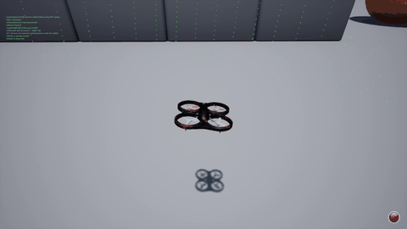
Challenges
1. AttributeError on KinematicsState: state.kinematics_estimated.pose did not exist. Use position + orientation separately.
2. Obstacle Too Close False Positives: LiDAR noise and thresholds caused false positives. Adjust OCCUPIED_THRESHOLD.
3. Random Circling: CNN corrections (untrained) and moving grid origin caused oscillations.
3A. Random Lunging (shown in gif): No CNN applied but PD velocity commands do not smoothly mesh with each other
4. Altitude Drift: Solved with PID controller for vertical velocity.

Slide 4
CNN Approach Consideration
Original plan: Use CNN to predict velocity corrections from LiDAR.
Problems: Untrained model → random outputs → circling.
Current decision: Disable CNN until baseline stable.
Future plan: Hybrid approach: A* path + trained CNN corrections.

Slide 5
Path Planning & Grid Issues
A* relies on occupancy grid.
Issues:
- Grid origin updated every loop → goal coordinates shift.
- LiDAR points occasionally mark free space as obstacles → frequent replanning.
Solutions:
- Fix grid origin at start position.
- Adjust WAYPOINT_TOL and REPLAN_INTERVAL.

Slide 6
Code Highlights
Altitude PID: vz = ALT_KP*error + ALT_KI*integral + ALT_KD*derivative
A* Planning: path = astar_grid(grid, start, goal)
LiDAR Transformation: pts_world = (R @ pts.T).T + [pos.x_val, pos.y_val, pos.z_val]
Path Following Loop: vx = (wx-px)/dist*FORWARD_SPEED, vy = (wy-py)/dist*FORWARD_SPEED, vz = altitude_hold()

Slide 7
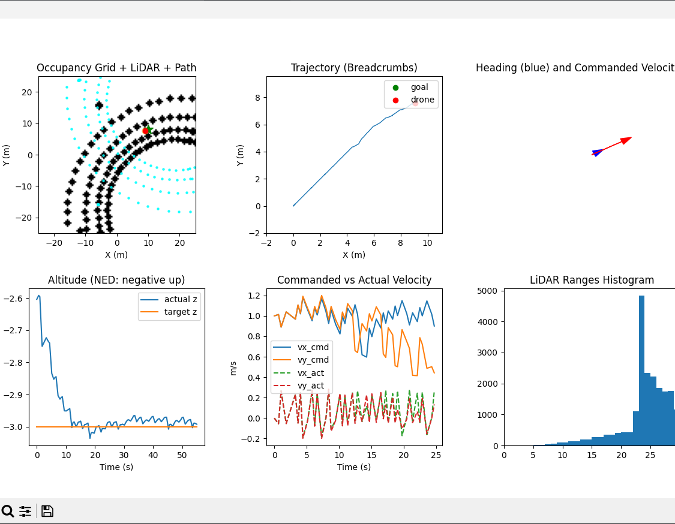
Graphical data
Ordered Top Left to Bottom Right
1. Helps visualize obstacle distribution and how the drone navigates around them
2. Confirms if navigation is stable, drifting, or circling
3. Allows you to compare what the drone thinks its heading is versus what motion command it is trying to execute
4. Checks for oscillations, instability, or poor landing/takeoff performance
5. Diagnoses flight-control mismatch
6. Detects noisy sensors, unexpected obstacles, or blind spots

Slide 8
Lessons Learned
Simulation physics and LiDAR noise can produce unexpected behaviors.
Hybrid AI + classical algorithms require careful handling of model influence.
Debugging requires live visualization of occupancy grid and drone position.
Parameter tuning (velocity, thresholds, PID) is critical for stable autonomous flight.

Slide 9
Tentative Next Steps
1. Implement fixed grid origin and waypoint tolerances.
2. Adjust LiDAR threshold and replanning interval.
3. Tune PID gains for smoother altitude.
4. Optional: Collect LiDAR/velocity dataset and train CNN.
5. Consider real-time goal adjustments via keyboard or GUI.

Slide 10
End of week 11/10 – 11/15 progress updates

